Slide 1
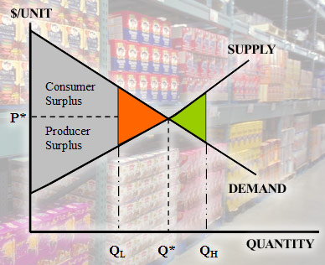
Microeconomics
Microeconomics
Unit 3: Chapters 4-7
Unit 3: Chapters 4-7

Slide 2
Essential Questions
1) How are households, businesses and government interrelated through markets and the flow of money?
2)What forces lead to changes in supply and demand?
3) How are prices established in a perfectly competitive market?
4) What factors affect the level of competition in various U.S. industries?

Slide 3
Microeconomics
Microeconomics
Part of economics that deals with behavior and decision making by small units, such as individuals and firms
“The small picture”
Modern microeconomics is about supply, demand, and market equilibrium.

Slide 4
Circular Flow Model of the Economy
Very complex due to the large number of individuals, groups, and institutions involved
CFM is a simplified view of the relationships that exist among various sectors and markets of an economy
Real Flow is the movement of goods, services, and resources
Money Flow is the movement of money between two sectors

Slide 5
Sectors (Participants)
Households- represents individuals and families that: 1) provide resources and 2)buy goods and services
Businesses- composed of the firms that: 1)buy resources and 2)produce goods and services
Governments- provides certain goods and services and collects taxes from the household and business sectors

Slide 6
Markets (where they are participating)
Product Market: markets where the buyers and sellers of all the different goods and services in the economy interact to determine the price and output of each item
Factor Market: markets where the buyers and sellers of the four types of resources (land, capital, labor and entrepreneurship) interact

Slide 7
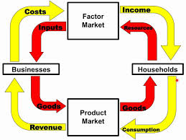
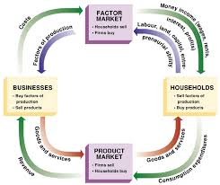
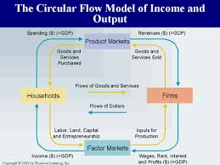
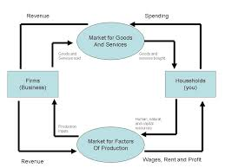
CFM

Slide 8
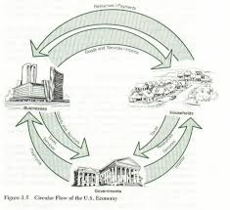
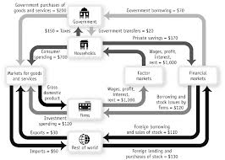
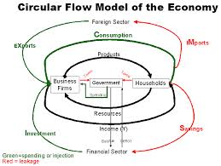
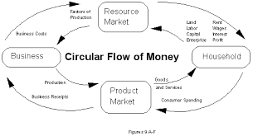

Slide 9
Product Market
Firms
Households
Gov
Factor Market

Slide 10
Fi
RM
PM
HH

Slide 11
HH
RM
PM
F

Slide 12
Demand
Demand
Desire, ability, and willingness to buy a product
A schedule showing how many units of a good or service consumers are willing to buy at a series of prices (NOT A SPECIFIC NUMBER)
Quantity Demanded
The amount of a good that buyers are willing and able to purchase at a given price. (SPECIFIC NUMBER)
Law of Demand
The law of demand states that, other things equal (Ceteris Paribas), the quantity demanded of a good falls when the price of the good rises. They are inversely related.
In other words: Low price = High quantity High price = Low quantity
Marginal Benefit VS Marginal Cost
Marginal Utility
Extra satisfaction from acquiring one more unit
Diminishing Marginal Utility
The more units of a certain economic product a person acquires, the less eager that person is to buy more

Slide 13
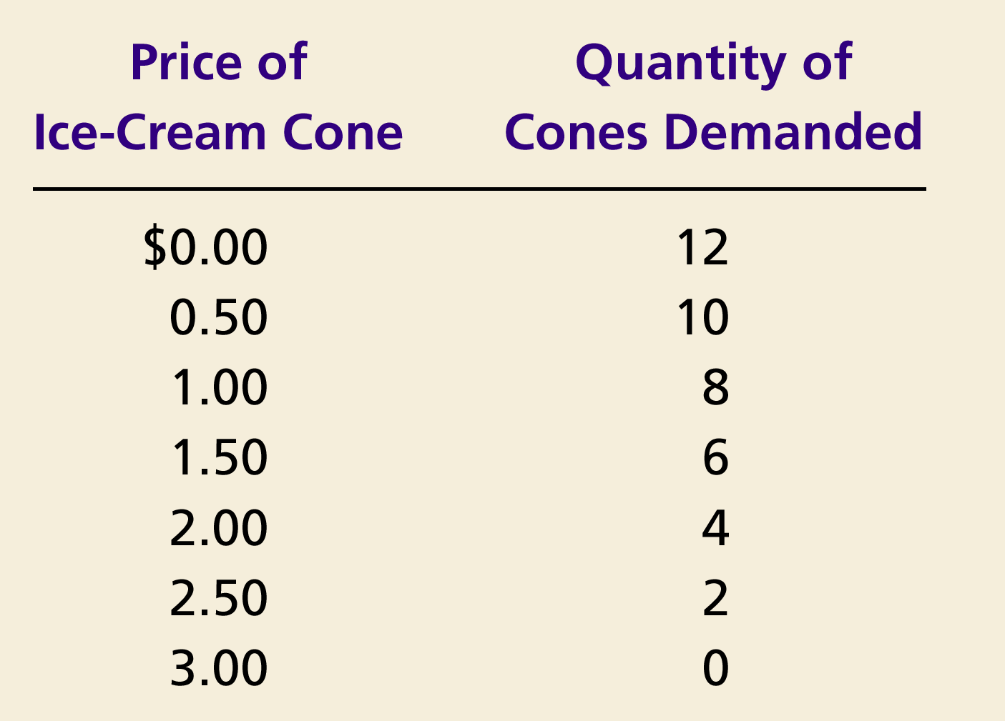
Demand Schedule
Table that shows the relationship between the price of the good and the quantity demanded.

Slide 14
Demand Curve
Demand Curve
The demand curve is a graph of the relationship between the price of a good and the quantity demanded.

Slide 15
Demand Curve for Ice Cream Cones
Price of
Ice-Cream Cone
$3.00
2.50
1. A decrease
2.00
in price
...
1.50
The demand curve slopes downwards from left to right (a negative slope), indicating the Law of Demand.
1.00
0.50
0
1
2
3
4
5
6
7
8
9
10
11
12
Quantity of
Ice-Cream Cones
2.
...
increases quantity
of cones demanded.

Slide 16
Shifts and Changes in Demand
What could cause a change in the amount of a product that people buy?
Price
Change in income
Change in tastes
Change in related products
Substitutes
Products that can bought in place of each other
Changes in the price of a substitute can change the demand of the related product
Complements
Products that are bought to work together
Ex. hot dogs and hot dog buns, film and cameras
Changes in the price of a complement can change the demand of the related product
Change in expectations
Change in number of consumers in the market

Slide 17
Shifts and Changes in Demand cont.
Changes in Quantity Demanded (Qd)
If there is a change in PRICE for the product, then there is a change in the QUANTITY DEMANDED (Qd) for that product.
This a movement ALONG the demand curve.

Slide 18
Changes in Quantity Demanded
Price of Ice-Cream Cones
A tax is levied that raises the price of ice-cream cones results in a movement ALONG the demand curve.
B
$2.00
A
1.00
D
0
4
8
Quantity of Ice-Cream Cones

Slide 19
Shifts and Changes in Demand cont.
Change in Demand
Change in Demand Handout
If anything else changes, then there will be a change in DEMAND.
Change in income
Change in tastes
Change in related products
Change in expectations
Change in number of consumers
This results in a shift in the demand curve, either to the left or right.
Causes a change that alters the quantity demanded at every price.

Slide 20
Shifts in the Demand Curve
An increase is always to the right and a decrease is always to the left.
Price of
Ice-Cream
Cone
Increase
in demand
Decrease
in demand
Demand
curve,
D
2
Demand
curve,
D
1
Demand curve,
D
3
0
Quantity of
Ice-Cream Cones

Slide 21
Shifts and Changes in Demand cont.
A closer look at changes in income
Normal Good
A good that consumers demand more when their incomes increase
Inferior Good
A good that consumers demand less when their incomes increase

Slide 22
Consumer Income Normal Good
Price of Ice-Cream Cone
$3.00
An increase in income...
2.50
Increase
in demand
2.00
1.50
1.00
0.50
D₂
D₁
Quantity of Ice-Cream Cones
0
1
2
3
4
5
6
7
8
9
10
11
12

Slide 23
Consumer Income Inferior Good
Demand Practice Handout
Price of Ice-Cream Cone
$3.00
2.50
An increase in income...
2.00
Decrease
in demand
1.50
1.00
0.50
D₁
Quantity of Ice-Cream Cones
0
1
2
3
4
5
6
7
8
9
10
11
12

Slide 24
Demand Elasticity
Demand Elasticity
Term used to indicate the extent to which changes in price cause changes in Qd
Measure of how much buyers respond to changes in market conditions
Percentage change in quantity demanded given a percent change in the price.
Elastic Demand
Qd responds strongly to changes in price.
Inelastic Demand
Qd does not respond strongly to price changes.
Unitary Elastic Demand
Qd responds in direct proportion to price changes.
Determinants of elasticity
Availability of close substitutes
Necessities VS Luxuries
Time Horizon
More Time = More Elastic

Slide 25
Total Revenue Test and Elasticity
Total revenue is the amount paid by buyers and received by sellers of a good.
Computed as the price of the good times the quantity sold.
This only tells you if it is inelastic, elastic, and unitary elastic, but not by how much.
TR = P x Q

Slide 26
Total Revenue Test and Elasticity
Price
$4
P × Q = $400
P
(revenue)
Demand
0
100
Quantity
Q

Slide 27
Total Revenue Test and Elasticity
With an inelastic demand curve, an increase in price leads to a decrease in quantity that is proportionately smaller. Thus, total revenue increases.

Slide 28
Total Revenue Test and Elasticity
Price
Price
An Increase in price from $1
to $3 …
… leads to an Increase in total revenue from $100 to $240
$3
Revenue = $240
$1
Revenue = $100
Demand
Demand
0
100
Quantity
0
80
Quantity

Slide 29
Total Revenue Test and Elasticity
With an elastic demand curve, an increase in the price leads to a decrease in quantity demanded that is proportionately larger. Thus, total revenue decreases.

Slide 30
Total Revenue Test and Elasticity
Price
Price
An Increase in price from $4
to $5 …
… leads to an decrease in total revenue from $200 to $100
$5
$4
Demand
Demand
Revenue = $200
Revenue = $100
0
50
Quantity
0
20
Quantity

Slide 31
Elasticity cont.
Because the price elasticity of demand measures how much quantity demanded responds to the price, it is closely related to the slope of the demand curve.

Slide 32
Perfectly Inelastic Demand
(a) Perfectly Inelastic Demand: Elasticity Equals 0
Price
Demand
$5
4
1. An
increase
in price . . .
0
100
Quantity
2. . . . leaves the quantity demanded unchanged.

Slide 33
Inelastic Demand
Price
$5
4
Demand
0
90
100
Quantity

Slide 34
Unit Elastic Demand
Price
$5
4
Demand
0
80
100
Quantity

Slide 35
Elastic Demand
(d) Elastic Demand: Elasticity Is Greater Than 1
Price
$5
4
Demand
0
50
100
Quantity

Slide 36
Perfectly Elastic Demand
Price
1. At any price
above $4, quantity
demanded is zero.
$4
Demand
2. At exactly $4,
consumers will
buy any quantity.
0
Quantity

Slide 37
Supply
Supply
The schedule of quantities that would be offered for sale at all possible prices that could prevail in the market. (NOT A SPECIFIC NUMBER)
Quantity Supplied
Amount offered for sale at a given price. (SPECIFIC NUMBER)
Law of Supply
The law of supply states that, other things equal (Ceteris Paribas), the quantity supplied of a good rises when the price of the good rises.
In other words: Low price = Low quantity High price = High quantity

Slide 38
Supply Schedule
Table that shows the relationship between the price of the good and the quantity supplied.

Slide 39
Supply Curve
Supply Curve
The graph of the relationship between the price of a good and the quantity supplied.

Slide 40
The supply curve slopes upwards from left to right (a positive slope), indicating the Law of Supply.
Price of
Ice-Cream
Cone
$3.00
2.50
1. An
increase
in price
...
2.00
1.50
1.00
0.50
0
1
2
3
4
5
6
7
8
9
10
11
12
Quantity of
Ice-Cream Cones
2.
...
increases quantity of cones supplied.

Slide 41
Shifts and Changes in Supply
What could cause a change in the amount of a product that producers sell?
Price
Change in inputs
FOP
Change in productivity of workers
Change in technology
Change in the number of sellers
Taxes and subsidies
Increase in taxes causes decrease in supply
Increase in subsidies causes increase in supply
Expectations
Government regulations

Slide 42
Shifts and Changes in Supply cont.
Changes in Quantity Supplied (Qs)
If there is a change in PRICE for the product, then there is a change in the QUANTITY SUPPLIED (Qs) for that product.
This a movement ALONG the supply curve.

Slide 43
Change in Quantity Supplied
Price of Ice-Cream Cone
S
C
$3.00
A rise in the price of ice cream cones results in a movement along the supply curve.
A
1.00
Quantity of Ice-Cream Cones
0
1
5

Slide 44
Shifts and Changes in Supply cont.
Change in Supply
If anything other than price changes, then you have a change in SUPPLY
Change in inputs
FOP
Change in productivity of workers
Change in technology
Change in the number of sellers
Taxes and subsidies
Increase in taxes causes decrease in supply
Increase in subsidies causes increase in supply
Expectations
Government regulations
A shift in the supply curve, either to the left or right.
Causes a change that alters the quantity demanded at every price.

Slide 45
Again, an increase is always to the right and a decrease is always to the left.
Price of
Ice-Cream
Supply curve,
S
3
Supply
Cone
curve,
S
1
Supply
Decrease
curve,
S
2
in supply
Increase
in supply
0
Quantity of
Ice-Cream Cones

Slide 46
Prices: Supply and Demand Combined
Why are prices good?
Neutral
They don’t favor the buyer or seller
Flexible
Reacts to change and adjusts
No administrative costs
Efficient
Make decisions easily
Keeps shortages from occurring

Slide 47
Prices: Supply and Demand Combined cont.
What happens without prices?
Rationing
Government decides what is a fair amount
High administrative costs
Bureaucracy
Diminished incentive
Waste

Slide 48
Prices: Supply and Demand Combined cont.
How are prices determined?
What are you trying to reach?
Market Equilibrium
Situation in which prices are relatively stable and
Qs = Qd
Equilibrium Price
The price that balances quantity supplied and quantity demanded.
On a graph, it is the price at which the supply and demand curves intersect.
Equilibrium Quantity
The quantity supplied and the quantity demanded at the equilibrium price.
On a graph it is the quantity at which the supply and demand curves intersect.

Slide 49
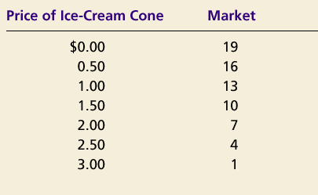
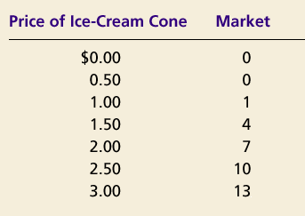
Prices: Supply and Demand Combined cont.
Demand Schedule
Supply Schedule
At $2.00, the quantity demanded is equal to the quantity supplied!

Slide 50
Prices: Supply and Demand Combined cont.
Price of
Ice-Cream
Cone
Supply
Equilibrium price
Equilibrium
$2.00
Equilibrium
Demand
quantity
0
1
2
3
4
5
6
7
8
9
10
11
12
13
Quantity of Ice-Cream Cones

Slide 51
Prices: Supply and Demand Combined cont.
Surplus
When price > equilibrium price, then quantity supplied > quantity demanded.
There is excess supply or a surplus.
Suppliers will lower the price to increase sales, thereby moving toward equilibrium.

Slide 52
Prices: Supply and Demand Combined cont.
Price of
Ice-Cream
Supply
Cone
Surplus
$2.50
2.00
Demand
0
4
7
10
Quantity of
Quantity
Quantity
Ice-Cream
demanded
supplied
Cones

Slide 53
Prices: Supply and Demand Combined cont.
Shortage
When price < equilibrium price, then quantity demanded > the quantity supplied.
There is excess demand or a shortage.
Suppliers will raise the price due to too many buyers chasing too few goods, thereby moving toward equilibrium.

Slide 54
Prices: Supply and Demand Combined cont.
Price of
Ice-Cream
Supply
Cone
$2.00
1.50
Shortage
Demand
0
4
7
10
Quantity of
Quantity
Quantity
Ice-Cream
supplied
demanded
Cones

Slide 55
Price Ceilings and Floors Tampering with the Laws of Economics
Price Ceiling
Maximum legal price that can be charged
Price Floor
Lowest legal price to be paid for a good
Minimum Wage

Slide 56
Effects of a Price Ceiling
Price
Supply
$7
$5
Shortage
Demand
0
4
7
10
Quantity
Quantity
Quantity
supplied
demanded

Slide 57
Effects of a Price Floor
Price of
Corn
Supply
Surplus
$3
$1
Demand
0
4
7
10
Quantity of
Quantity
Quantity
Corn
demanded
supplied

Slide 58
Shifts and the Equilibrium Price
Shifts in Curves VS Movements along Curves
A shift in the supply curve is called a change in supply.
A movement along a fixed supply curve is called a change in quantity supplied.
A shift in the demand curve is called a change in demand.
A movement along a fixed demand curve is called a change in quantity demanded.

Slide 59
Shift in Supply
Price of
Ice-Cream
1. An increase in the
Cone
price of sugar reduces
S₂
the supply of ice cream. . .
S₁
$2.50
2.00
Initial equilibrium
2. . . . resulting
in a higher
price of ice
cream . . .
Demand
0
4
7
Quantity of
3.
. . .
and a lower
Ice-Cream Cones
quantity sold.

Slide 60
Shift in Demand
Price of
Ice-Cream
1. Hot weather increases
Cone
the demand for ice cream . . .
Supply
$2.50
New equilibrium
2.00
2. . . . resulting
in a higher
price . . .
D
D
0
7
10
Quantity of
3.
. . .
and a higher
Ice-Cream Cones
quantity sold.

Slide 61
Theory of Production
Why do producers raise prices when people demand more a product?
Cost of production
Short run
To increase production, variable inputs must change
Hire more employees
Long run
All inputs can vary
Build a new factory, but it takes time

Slide 62
Cost VS Revenue Profits
Cost
Fixed
Cost that a business incurs even if output is zero
Rent, property taxes, salaried employees, interest on loans
Depreciation
Wear and tear of machines
Variable
Cost that changes with the rate of operation
Labor, raw materials
Total
Fixed + Variable
Marginal
Extra cost incurred when a business produces one additional unit of output
Revenue
Total
(Number of units) X (Average price per unit)
Marginal
Extra revenue associated with the production and sale of one additional unit
(Change in total revenue) / (Change in quantity)

Slide 63
Cost VS Revenue and Profits
What is the point of starting a business?
Profit Motive: reason for new, better products…higher standard of living, etc
Profit is the firm’s total revenue minus its total cost.
Profit = Total revenue - Total cost
The Firm’s Objective
The economic goal of the firm is to maximize profits.
This occurs where
MARGINAL REVENUE = MARGINAL COST

Slide 64
# of Programs | Total Fixed Costs | Total Variable Costs | Total Costs | Marginal Costs | Price | Total Revenue | Marginal Revenue | Profit or loss
0 | $60 | $0 | $60 | X | X | $0 | X | -$60
1 |  | $45 | $105 | $45 | $56 | $56 | $56
2 |  | $85 |  | $40
3 | $60 | $120 |  |  |  |  | $56 | -$12
4 |  | $150
5 |  | $185 |  |  | $56
6 | $60 | $225 |  |  |  |  |  | $51
7 |  | $270 |  |  |  |  | $56
8 |  | $325 |  |  | $56
9 |  | $390 | $450 |  |  | $504
10 |  | $465 |  | $75
$60
-$49
$60
$145
$56
$112
$56
-$33
$180
$35
$56
$168
$60
$210
$30
$56
$224
$56
$14
$60
$245
$35
$280
$56
$35
$285
$40
$56
$336
$56
$60
$330
$45
$56
$392
$62
$60
$385
$55
$448
$56
$63
$60
$65
$56
$56
$54
$60
$525
$56
$560
$56
$35

Slide 65
Competition and Market structures
Industry VS Firm
Firm
Individual producer
Industry
All producers collectively
4 types
Pure or Perfect Competition
Monopolistic Competition
Oligopoly
Monopoly

Slide 66
Pure Competition
Farmers Market
5 Conditions
1) Lots of buyers and sellers
So many that one buyer or seller cannot influence the market or the price
2) Buyers and sellers deal with identical products
No difference in quality, no such thing as a brand name, no need to advertise
3) Each buyer and seller acts independently
Lots of competition between everyone
4) Buyers and sellers are all reasonably well-informed
5) Buyers and sellers are free to enter and leave the market

Slide 67
Pure Competition cont.
Since no firm or individual can influence the price, they must sell at whatever the market dictates based on the Equilibrium price and quantity
Maximize profits by finding a production where MC=MR given the market price.
Pure competition only takes place if all 5 conditions are met.

Slide 68
Monopolistic Competition
Shoes, Jeans
All conditions present except identical products
Firm tries to make product a little different to attract more buyers and monopolize a segment of the market
Do this through Product Differentiation
Products are similar, but different
This difference may be real or perceived
Non price Competition
Advertising or other campaigns try to convince buyers that products are better than others.
Make the consumer think that product is so special, nothing comes close to it. If this happens, firm can charge a higher price

Slide 69
Monopolistic Competition cont.
Profit Maximization
Similar products generally sell within a narrow price range
Seller must raise and lower price within the range

Slide 70
Oligopoly
Airlines, oil companies, car companies, soft drinks, fast food
Few large sellers dominate the market
One firm has a larger impact on supply and price
Further from pure competition than monopolistic competition
Little independent behavior
Less competition means more influence in the market; therefore, when one firm does something, others react quickly.
Collusion
Formal agreement to set prices or cooperate in other ways
Illegal
Price fixing
Agreement to charge the same or similar prices
Very illegal, but hard to prove

Slide 71
Oligopoly cont.
Pricing behavior
Since others react quickly to changes in price, price wars can occur
Series of price cuts that lead to unusually low prices
Raising or lowering prices can be risky
Price leadership
One firm sets the price and others follow because it controls so much of the market
Non price competition is used a lot in this type of market
Prices are usually higher than monopolistic competition and much higher than pure competition

Slide 72
Monopoly
Georgia power
One seller
Very few of these in U.S.
Americans do not like them
Usually can find a reasonably close substitute
New technology can lead to new products to compete with the monopoly

Slide 73
Monopoly cont.
Types of monopolies
Natural Monopoly
Market situation where costs are minimized by having a single firm produce the product
Utility companies
Franchise
Government gives permission to be a monopoly
Sometimes leads to lower costs
Economies of Scale
As a firm grows, it usually becomes more efficient at producing products
Geographic Monopoly
Monopoly based on location
Gas station in the middle of nowhere

Slide 74
Monopoly cont.
Types of monopolies
Technological monopoly
Special privilege given to those who invent a new product
Patent
Exclusive right to manufacture, use, or sell any new and useful art, machine, manufacturing process, or composition of matter, or any new and useful improvement thereof.
Copyright
Same thing as a patent only used for art or literary work
Government Monopoly
Business that the government owns and operates
Usually involves things people need that private businesses may not adequately provide
Police and fire protection, army

Slide 75
Market Failures
Markets work best when…
There is adequate competition
Buyers/Sellers are well informed
Resources move freely
Prices reasonably reflect production cost
When these conditions are not met, market failures occur.

Slide 76
Market Failures
Examples
Inadequate competition
Dangers of monopolies
Artificial shortages and high prices
Inefficiency
Businesses gain political power
More competitive market = More fair
Businesses will tell on each other if they break the law, just like in sports
Inadequate information
Need information to be efficient
May not get the best buy/sell price

Slide 77
Market Failures
Examples cont.
Resource immobility
When large factories or military bases close, people may want to stay in city instead of moving to find a new job
Leads to artificially high price of labor in cities that need workers and artificially low price of labor in the cities former employees stay
Externalities
Economic side effect that either benefits or harms a 3rd party not directly involved in activity
Example: Building or expanding an airport
Considered a failure because their costs and benefits are not reflected in the price of the action
Negative: Actions harm 3rd party
Positive: Actions help 3rd party
Public Goods
Examples: interstates, public buildings
Considered failure because decisions maybe made that ignore market forces. In other words, the government will build it even if it does not make economic sense to do so.

