Slide 1
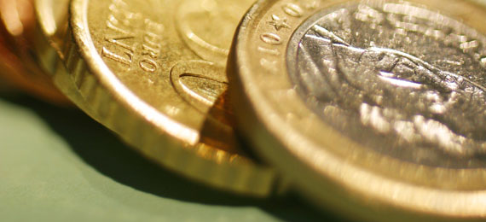
Introduction to Economics
Introduction to Economics
Unit 1: Chapters 1-3
Unit 1: Chapters 1-3

Slide 2
Essential Questions
1) Why do people have to make decisions?
2) Why should people weigh the advantages and disadvantages of different alternatives when making choices?
3) Why do people not create all their own goods and services?
4) How do various economic systems answer the three basic questions differently?
5) What are the roles of government in a market economy?
6) How does investment affect productivity and economic growth?
7) How are households, business and government interrelated through markets and the flow of money?

Slide 3
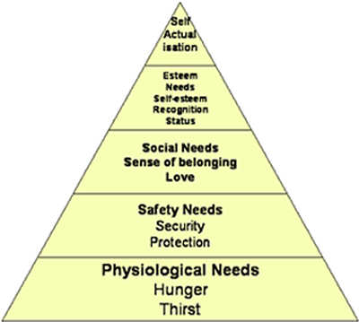
Needs VS Wants
Need
Something that is necessary for survival
Ex. Food, Shelter, Companionship
Maslow’s Hierarchy of Needs

Slide 4
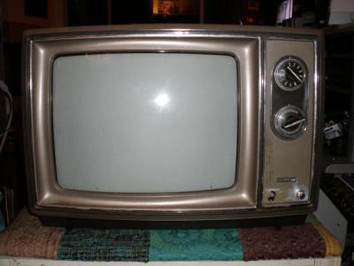
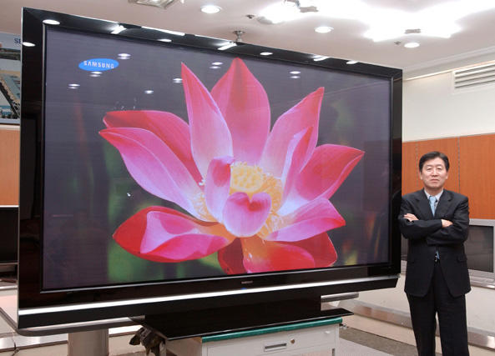
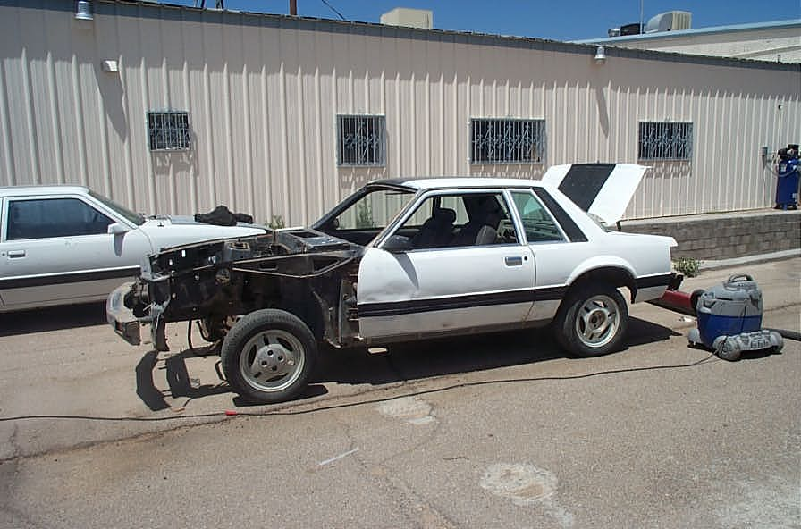
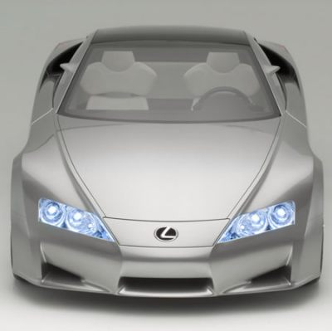
Needs VS Wants
Want
A way to express a need; may not be essential for survival
Ex. Steak, Lexus
Difference: need food, but you want a steak
Wants and needs are UNLIMITED

Slide 5
Factors of Production (FOP)
Remember: Wants and needs are UNLIMITED
We need things to meet these wants and needs
Ex. 50” Plasma TV
What do we need to make this?

Slide 6
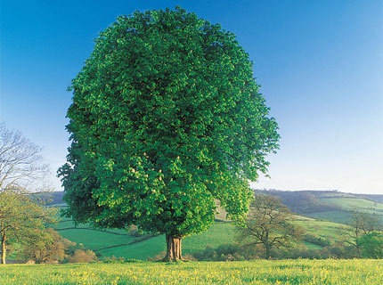
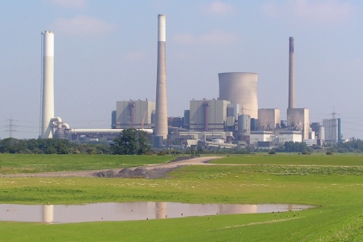
Factors of Production (FOP)
These are called the Factors of Production
Land, Labor, Capital, and Ideas or entrepreneurs
Land: “gifts of nature” such
as trees, deserts, sunlight,
water, cows, climate
Labor: people with their
efforts, skills, and abilities
Capital: tools, equipment,
and factories used in the
production of goods and
services. ex. bulldozer,
cash register
Entrepreneurs: risk taker in
search of profit, brings all these
resources together with ideas
These resources or FOP are all LIMITED

Slide 7
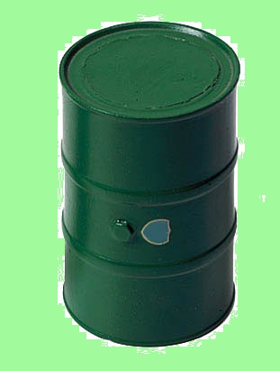
Scarcity
Thus, you have UNLIMITED wants and needs, but LIMITED resources with which to meet those needs.
Economists refer to this problem as scarcity
Definition of Economics: study of human efforts to satisfy what appear to be unlimited and competing wants through the careful use of scarce resources

Slide 8
Tradeoffs and Opportunity Cost
Since resources are scarce, we as a society must figure out a way to distribute them; we must make choices.
Tradeoffs
Alternative choices for spending income and time
Opportunity cost
The cost of the next best alternative use of money, time, or resources when one choice is made rather than another
VS

Slide 9
Thinking at the Margin
Marginal = The Extra
Marginal changes are small, incremental adjustments to an existing plan of action.
Marginal Benefit
The extra benefit of one more unit
Benefit will correlate with the value that we place on the product
Value = How much something is worth
Paradox of Value
The contradiction between the high value nonessentials and low value of essentials
Marginal Cost
The extra cost of one more unit
The decision to choose one alternative over another occurs when that alternative’s marginal benefits exceed its marginal costs!
Individuals have an INCENTIVE to gain from a transaction.
Hope of reward or fear of punishment that encourages people to behave in a certain way.

Slide 10
Production Possibilities Frontier
Production Possibilities Frontier (PPF) or Production Possibilities Curve (PPC)
Graph that shows the combinations of output that the economy can possibly produce given the available factors of production and the available production technology.
Concepts Illustrated by the Production Possibilities Frontier
Efficiency
Tradeoffs
Opportunity Cost
Economic Growth

Slide 11
The PPF for a given country GUNS VS BUTTER
Quantity of
Guns
3,000
D
2,200
C
2,000
A
Production
possibilities
B
frontier
1,000
300
600
700
1,000
Quantity of Butter
Thousands of lbs

Slide 12
Shifts in PPFs/PPCs
Our PPF can shift in and out
In = Production Possibilities are Shrinking
What could cause this?
War, disease, restrictive governments, natural disasters
Out = Production Possibilities are Growing
What could cause this?
Immigration, technology
Investing causes growth
Human Capital
Sum of motivations, skills, health, and abilities
Leads to increases in efficiency and higher standard of living
Standard of Living
Quality of life based on necessities and luxuries that make life easier
Measured using Per Capital GDP, Life Expectancy, and Availability of consumer goods

Slide 13
A Shift in the PPF GUNS VS BUTTER
Quantity of
Guns
4,000
3,000
2,100
E
2,000
A
700
750
1,000
Quantity of Butter
Thousands of lbs

Slide 14
More Choices: 3 Basic Economic Questions
1. What to produce?
Goods and Services
Good
Tangible commodity
Consumer Good: Intended for final use by consumer
Capital Good: A good used to make other goods and services
Durable Good: Lasts 3 or more years with regular use
Nondurable Good: Lasts less than 3 years with reg. use
Services:
Work that is performed for someone; can’t be touched or felt
2. How to produce?
Hand made; with robots; in China, Mexico, or South GA
3. For whom to produce?
Consumers
People using goods and services
What type of consumer? Man? Woman? Rich? Poor? Americans? French?
Consumption
The process of using up goods and services
Conspicuous Consumption
Use of goods and services to impress others

Slide 15
Even More Choices: Goals for a Society
Broad Social Goals Handout
Economic Efficiency
Refers to how well scarce productive resources are allocated to produce the goods and services people want and how well inputs are used in the production process to keep production costs as low as possible.
Economic Equity
Means what is “fair.” Economic actions and policies have to be evaluated in terms of what people think is right or wrong. This usually deals with questions of income and wealth. Equal outcomes VS equal opportunities.
Economic Freedom
Refers to things such as the freedom for consumers to decide how to spend and save their incomes, the freedom of workers to change jobs and join unions, and the freedom of individuals to establish new businesses and close old ones.
Economic Growth
Refers to increasing the production of goods and services over time.
Economic Security
Refers to protecting consumers, producers, and resource owners from risks that exist in society. Each society must decide from which uncertainties individuals can and should be protected and whether individuals, employers, or the government should pay for this protection.

Slide 16
Types of Economies
Societies must answer the 3 Basic Questions and decide what goals are important to them. Thus, they organize their economies into 4 basic categories based on how they answer these questions and how they rank the economic goals of their society.
Traditional
Characteristics, strengths, weaknesses
Command
Characteristics, strengths, weaknesses
Market
Characteristics, strengths, weaknesses
“Laissez Faire” and Adam Smith
Mixed (U.S.)
Characteristics, strengths, weaknesses

Slide 17
Our Version of the Mixed Economy: The Free Enterprise System
Free Enterprise System Characteristics
Economic Freedom
Voluntary Exchange
Buyers and sellers freely and willingly engaging
Both are better off after the exchange, because they believe that what they receive is worth more than what they gave.
In other words, their Marginal Benefit was greater than their Marginal Cost
Private Property
Concept that people have the right and privilege to control their possessions as they wish
House/Car or Talents/Skills
Profit Motive
Parties must believe they profit from exchange: MB > MC
Profit
Extent to which person or organization believes he/she is better off at the end of a period than they were at the beginning
Profit Motive
Force that drives people to improve their well-being
Responsible for most growth
The incentive to make profit

Slide 18
Free Enterprise System cont.
Capitalism
System where individuals own FOP
Competition
Struggle to attract buyers
Free Enterprise System allows this to flourish
Incentives Help Drive Competition
Businesses have an incentive to be efficient and keep costs low to increase profits.
Individuals have an incentive to be efficient to be able to buy more goods and services
Thus, our system has built in incentives to become more efficient

Slide 19
Free Enterprise System cont.
Roles in the System
Entrepreneur
Risk taker; Identifies area to make a profit
Others notice profit and create competition
Consumer
Determine what is produced
Consumer Sovereignty
“Ruler of the Market”
Government
Protector
Protects individuals ex. FDA, SEC, FBI
Enforces contracts, protects private property, ensures fair play
Producer and Consumer
Provides services ex. Police, army, schools
Consumes factors to produce things
Regulator
Preserves competition ex. Microsoft
Oversees communication, nuclear power, banking
Promoter of national goals
Creates mixed economy
People carry on economic affairs freely, but are subject to economic intervention and regulation

Slide 20
How does investment affect productivity and economic growth?
Resources are scarce…societies want to improve their Standard of Living (result of economic growth)
Societies must increase its productivity
It must produce more output (products) per each unit of resources they use, or input.

Slide 21
Capital Investment
Buy new machines and equipment
Research and implement new technologies
Improve the education of the workforce

Slide 22
Individual businesses have to make decisions with profits
Spend profits on a new car for your own personal use?
Put money in a savings account?
Invest the profits in your business?

Slide 23
Essential Questions
1) Why do people have to make decisions?
2) Why should people weigh the advantages and disadvantages of different alternatives when making choices?
3) Why do people not create all their own goods and services?
4) How do various economic systems answer the three basic questions differently?
5) What are the roles of government in a market economy?
6) How does investment affect productivity and economic growth?
7) How are households, business and government interrelated through markets and the flow of money?

